Slide 1
XYZ Wealth Management
Progress Review Meeting with
THE JANSSEN FAMILY
Prepared by: Joe Advisor

Slide 2
Progress review meeting agenda
❶ Changes we’re making to serve you better
❷ Wealth management discussion
❸ Review and discuss your investment costs
❹ Matters you’d like to discuss

Slide 3
We’re making changes to serve you better
Enhancing our statements
and client reports
Increased information on
fees and performance
Launching January 2017

Slide 4
At XYZ Wealth Management,
we take a different approach to wealth
We’re committed to helping you:
Build and protect your wealth and lifestyle
Plan for the expected and unexpected
Providing you peace of mind
Establish and protect your legacy

Slide 5
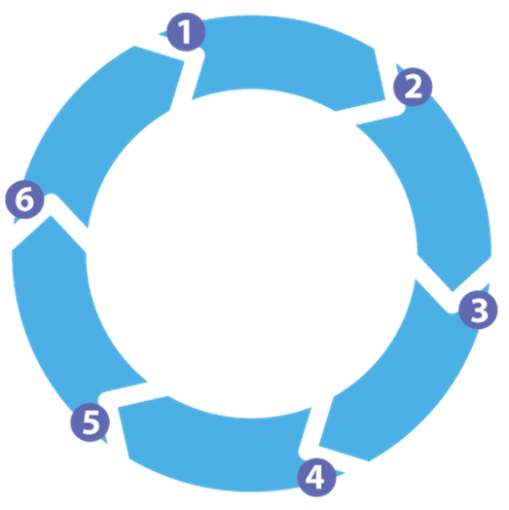
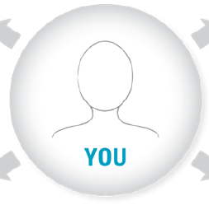
Our process for providing comprehensive advice
IDENTIFY YOUR NEEDS AND OBJECTIVES
MONITOR YOUR PROGRESS
GATHER INFORMATION
IMPLEMENT YOUR PLAN
PREPARE ANALYSIS
DEVELOP A WRITTEN
PLAN OF ACTION

Slide 6
Client Storyboard for the Janssen Family
Goals
Retire debt free by 65
Spend more time with family
Travel 2x per year
Pay for Francesca’s education
Relationships
Contingency planning
Son, Karl 24
Daughter, Francesca 18
Both parents approaching 90’s
Both have whole life -$500,000
Mortgage and disability insured
Will and POA docs up to date
No emergency fund
Assets
Debt
Phil RRSP: $334,000
Eva RRSP: $194,875
Joint Account: $27,450
RESP: $19,750
House: $420,000
Mortgage balance: $273,000
Joint line of credit: $25,000
Phil’s car balance: $12,000
Income
Phil Salary: $85,000
Eva Salary: $64,400
Dividends from investments

Slide 7
Your Progress Report
Top Priorities
Challenges
Retire debt free by 65
Maximize RESP contributions
Set up emergency fund
Next phase of financial plan
Aging parents require elder-
care housing
Francesca looking at colleges
in US – increased costs
Phil Janssen
Eva Janssen
Financial Management Retirement Planning |  | Tax Planning |  | Protection Legacy Planning
SERVICE | STATUS | SERVICE | STATUS | SERVICE | DETAILS & STATUS
Establish goals and financial plan | Initial discovery meeting completed 02.15.2000 Reviewed semi-annually | Tax mitigation | Tax mitigation through hold co since April 2006 | Life insurance | Whole life policy for both - $500k on 03.15.2000
Mortgage & debt analysis | On track to have mortgage paid off by 2020 | Tax return coordination | Joint filing through Accountant, James Jones since - April 2006 | Critical illness & disability | Mortgage protection set up 04.10.2000
Retirement planning | Retirement plan and cash flow forecast completed - 07.03.2013 | Tax optimization | Non -registered account using Corporate class | Wills and POA | Completed by Anderson Smith Law firm - 04.06.2009
Cash flow projections |  | Business tax planning | Tax filing through Accountant, James Jones since - April 2006 | Business succession planning | Completed - 09.15.2010
Service and communication | Service agreement created 02.17.2012 |  |  | Risk protection | Portfolio analysis and automatic rebalancing in place to minimize risk

Slide 8
Review of your investment costs
Management Fees
Tiered management fee (net of reductions)
Mandate Classification | Management Fee | $250,000 to $500,000 inclusive | $500,000 to $1 million inclusive | $1 million to $3 million inclusive | $3 million to $5 million inclusive | Amounts over $5 million
Money Market | 0.55% | 0.500% | 0.425% | 0.350% | 0.325% | 0.300%
Income* | 0.55% | 0.525% | 0.450% | 0.400% | 0.350% | 0.300%
Diversified Income/Balanced | 0.85% | 0.750% | 0.600% | 0.550% | 0.500% | 0.400%
Equity | 0.95% | 0.900% | 0.750% | 0.650% | 0.600% | 0.500%
Dealer and Advisor Fees
1.00%

Slide 9
Review of your investment costs
This example is based on a typical retail equity mutual fund in Canada with MER calculated in accordance with National Instrument 81-102. Mutual Funds in Canada may have slightly different breakdowns due to management fee rates, cost structure and operating efficiency. This example is for illustrative purposes only.

Slide 10
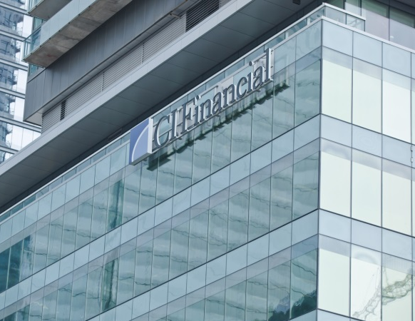
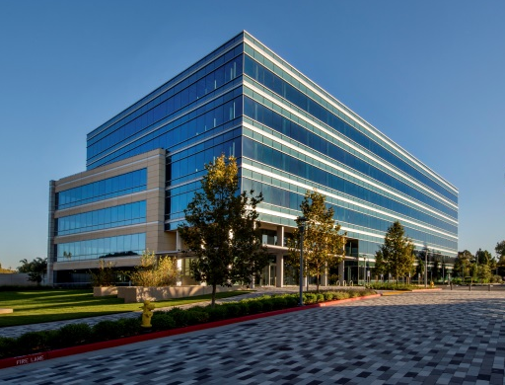
Review of your investment costs
$___________ invested with an MER of _____% = $________ per year
CI Investments
Advisor Dealership
Advisor & Team
$_________________
$_________________
$_________________
Services Provided
Portfolio Managers and Analysts | Compliance | Wealth and Financial Planning
Sales Taxes | Statements and Reports | Coaching and Advice
Client Services and Administrative Support | Access to Wealth Management Experts | Ongoing Monitoring and Tracking

Slide 11
Review of your investment costs
MERS - the Industry Range
3.52%
x
2.00%
0.96%
Low
High
Adapted from: The Costs and Benefits of Financial Advice - Forester, Linnainmaa, Melzer, Previtero Mar 2014

Slide 12
Our Wealth Management Services
At XYZ Wealth, we’re committed to providing you with an unrivaled wealth management experience. Our team is dedicated to building relationships that expand beyond your investments and providing you with personalized solutions. We offer a wide range of services coupled with a first-class client experience.
As part of the fees we charge, you are entitled to the following services and value-adds:
Financial Management | Asset Management | Tax Planning | Risk Management
Mortgage & debt analysis | Portfolio/pension analysis | Tax analysis | Life Insurance
Cash flow analysis | Diversified product offering | Tax return coordination | Critical illness & disability
Cash flow projection | Retirement/education/savings | In-depth personal tax planning | Long-term care insurance
RRSP/leverage loans | Repositioning/rebalancing | Business tax planning | Asset allocation to reduce risk
Establish financial goals | Maximizing risk-adjusted returns | Tax minimization strategies | Review of money managers
Retirement Planning | Legacy Planning | Life Planning | Client Experience
Retirement income analysis | Estate planning analysis | Eldercare issues | Deep client discovery
Assessment of objectives | Wills and POA | Workplace transitions | Behavioural management
Retirement expenses analysis | Charitable giving | Healthy living | Regular status reports
Retirement cash flow projection | Business succession planning | Referral to other professionals | Tailored communication
Retirement education sessions | Access to legal network | Other non-financial advice | Proactive problem resolution

Slide 13
How I can add more value
Intergenerational wealth meetings
Access to other experts
Support during life transition events
Images: iStock
Notes:
Now you want to talk about some value-added services that you have provided your clients. Services that are a bit out of the ordinary and show the client that you care about them as people because these services are more personal.
Here are some examples of value-added services that you can provide clients, and the beauty of these services is that they don’t involve a lot of extra effort or costs to carry out.
The first is IWM which is a meeting that you can facilitate to help clients discuss their wills and estate plans with their adult children. Research shows that 67% of clients do not discuss their intentions with their adult children. Avoiding this topic can make a lot of clients lose sleep because they know that it can cause problems with inheritors down the road.
Another value added service is providing your clients with access to lawyers who can help them set up these important documents. 58% of Canadians do not have a signed will…so there is a need for this service.
The third example of a value-added service is helping clients work through life transition events. Sooner or later every client is going to go through some kind of a life transition event. For example, demographics show that women will outlive men and that means more widows who will be left to manage their own finances which many may never have had to handle before. As a trusted advisor you will be able to help educate them and set up a budget or maybe a financial plan.

Slide 14
Matters you’d like to discuss
Image: ©iStock by Getty

